Slide 1

Visual Fire Detection and People Density Monitoring System
Team Members:
ADARSH MENON - 20BCR7010
N K V MANASA - 20BCR7035
FAZAL K MOHAMMAD – 20BCR7008
JUAN JOHNSON – 20BEC7007
GAUTHAM H S – 20BCE7190
ALEN SEBASTIAN V – 20BCR7018

Slide 2
AGENDA
Problem Statement
Abstract
Literature Review
Modules of the Project
Flowchart
Components
Architecture
Key Milestones
Conclusion
References

Slide 3
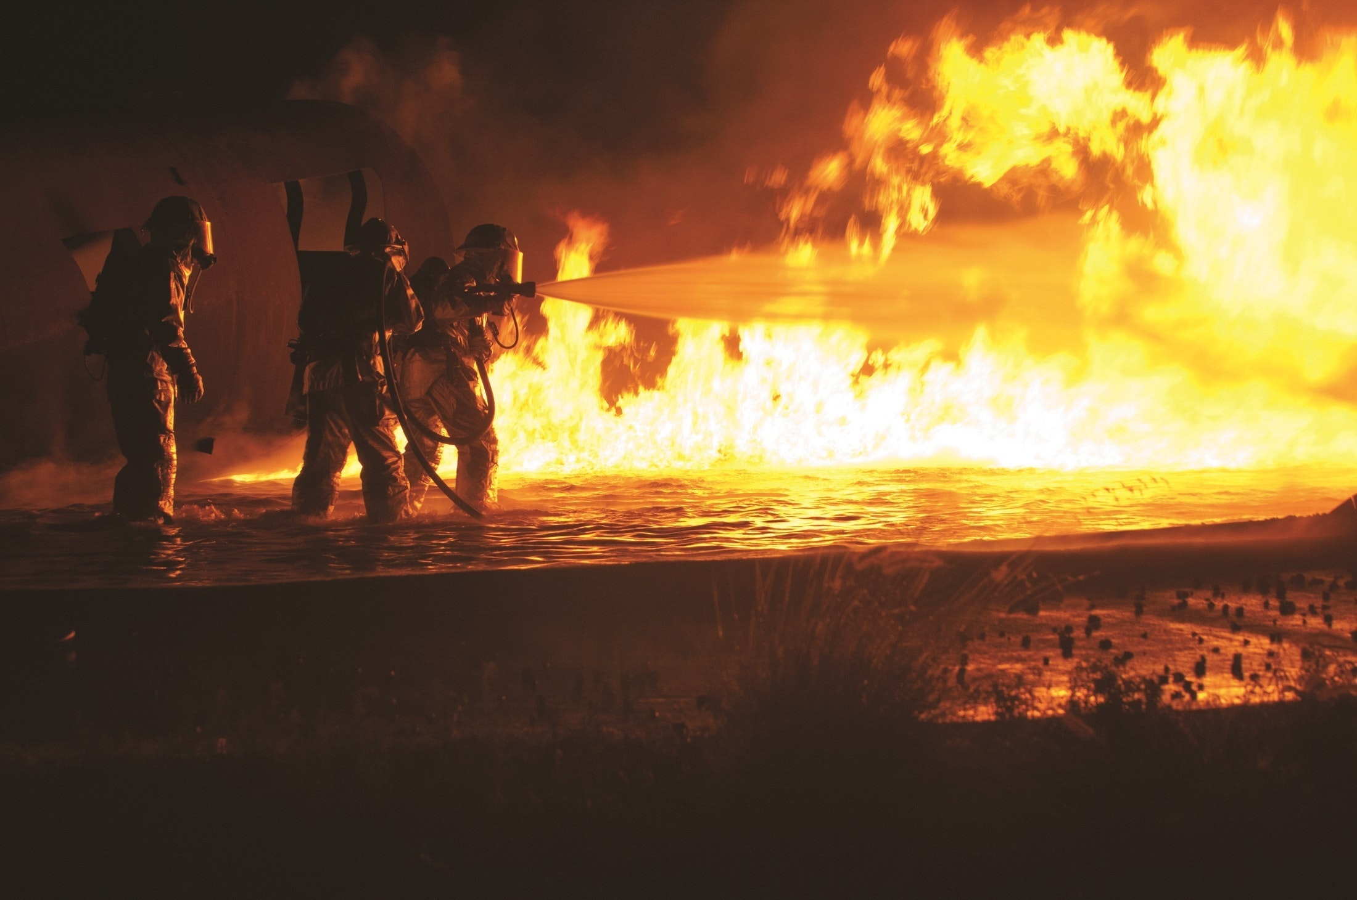
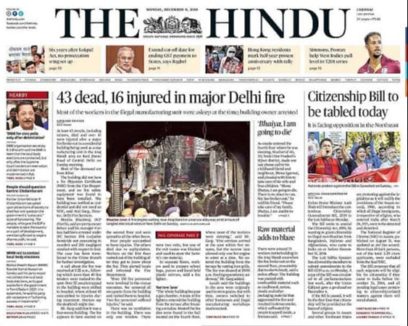

PROBLEM STATEMENT
Fire incidents have a huge damaging impact on human life as well as property in residential and industrial areas. On the other hand, the risk of fires is growing in conjunction with the growth of urban buildings due to increase in population and lack of ventilation. Traditional fire detection equipment’s have a chance of failure and also have a high possibility of giving false alarm moreover they cannot give dynamic attributes like number of people trapped in fire and the intensity of fire. One of the major problems among fire fighters is to find the number of trapped people in the building among all the smoke generated in fire

Slide 4
ABSTRACT
In this project, we propose an architecture using raspberry pi and a camera to provide an accurate number of people trapped in the building and moreover, find the location of trapped people and detect fire using, deep neural network (DNN) models, i.e.,InceptionV3 which are embedded in the vision node which is the camera and raspberry pi. We also use HOG descriptor algorithm to find out the estimated number of people trapped inside the whole building. A web application is developed and integrated with the vision node through a local server for visualizing the real-time events in the building related to the fire and getting the count of people. In this proposed system concentration on sensors are omitted with the usage of Inception v3, a widely-used image recognition model that has been shown to attain greater than 78.1% accuracy. In the proposed system, a webcam is used instead of a surveillance camera for convenience .

Slide 5
LITERATURE REVIEW
S.No | Title of Papers and Authors | Year | Existing Work
1 | Fire detection using smoke and gas sensors Chen, S. J., Hovde, D. C., Peterson, K. A., & Marshall, A. W[IEEE] | 2007 | Fire detection can be delayed due to smoke generation and detection time, leading to damage before prevention measures can be taken.
2 | Novel method of real time fire detection and video alerting system using open-cv techniques M. Karthikeyen, N. Ramya, M. Sai Priya and C. Yuvalakshmi[MDPI] | 2021 | Fire detection and giving alerts using mailing system which is a very traditional way and it is not sustainable
3 | Fire Detection Using Deep Learning And Opencv Vinaya Gawali, Saloni Pawar, Muskan Chhangani,Arsh Shrivastava,K.A. Kalokhe [] | 2022 | The system uses advanced Deep learning and Convolutional Neural Networks technology to detect the fire and OpenCV technology to capture the images

Slide 6
MODULES OF PROJECT
Fire Detection
This system utilizes the Inception V3 model which is made up of symmetric and asymmetric building blocks, including convolutions, average pooling, max pooling, concatenations, dropouts, and fully connected layers. Batch normalization is used extensively throughout the model and applied to activation inputs. Loss is computed using Softmax activation function.
It has a deeper network compared to the Inception V1 and V2 models, but its speed isn't compromised.
The Inception V3 model used several techniques for optimizing the network for better model adaptation. It has a deeper network compared to the Inception V1 and V2 models, but its speed isn't compromised. It is computationally less expensive. It uses auxiliary classifiers as regularizes.
A high-level diagram of the model is shown:

Slide 7
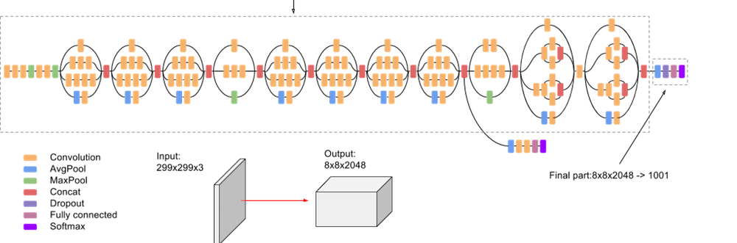

Slide 8
MODULES OF PROJECT
Counting of people
To get the estimated number of people in the building we will use the HOG detector. The HOG person detector uses a sliding detection window which is moved around the image. At each position of the detector window, a HOG descriptor is computed for the detection window. This descriptor is then shown to the trained SVM, which classifies it as either “person” or “not a person”.
Web Application
It then streams the real-time output and the live feed to a network, which is then parsed by an application listening to the stream port. This feed can then be used by the concerned authorities to plan out further steps and evacuation procedures.

Slide 9
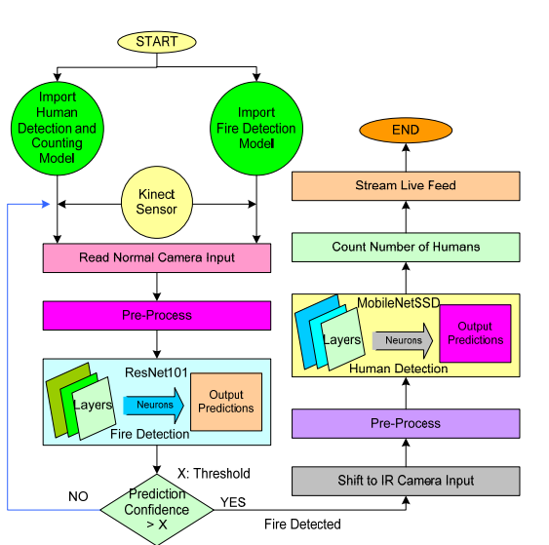
FLOWCHART OF PROPOSED ARCHITECTURE
HOG descriptor
InceptionV3

Slide 10
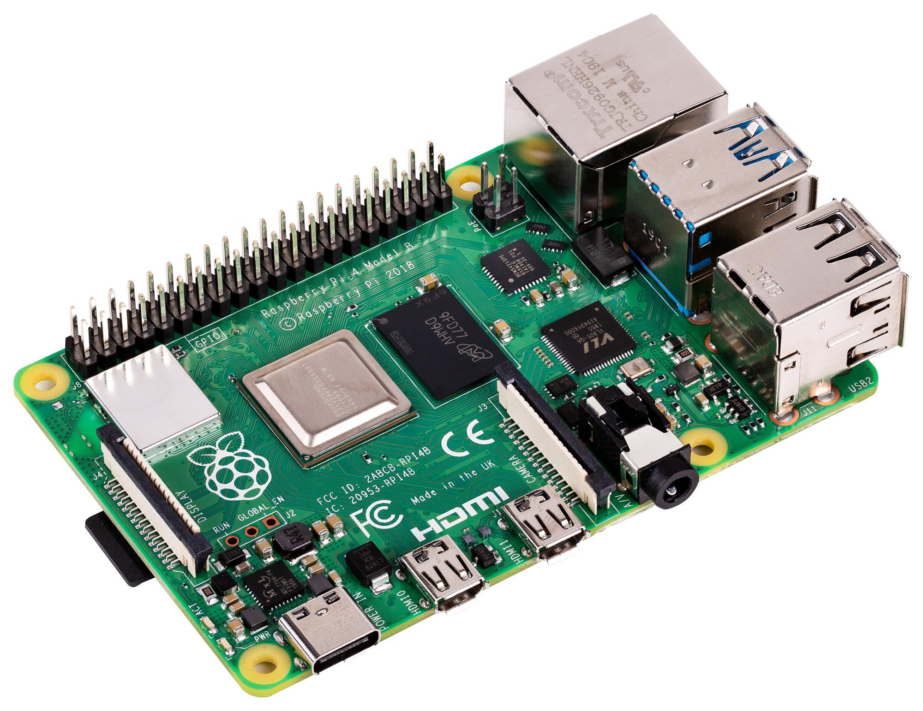
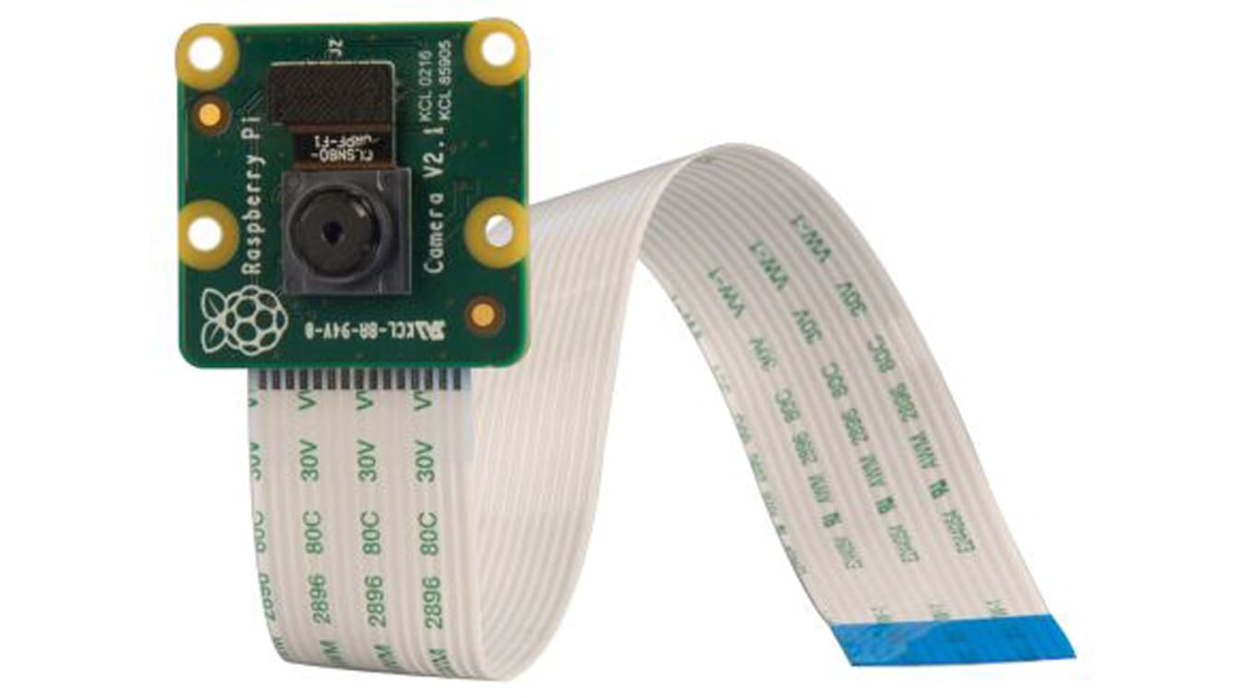
COMPONENTS
1) Raspberry Pi 4 Model B
2) Raspberry Pi Camera

Slide 11
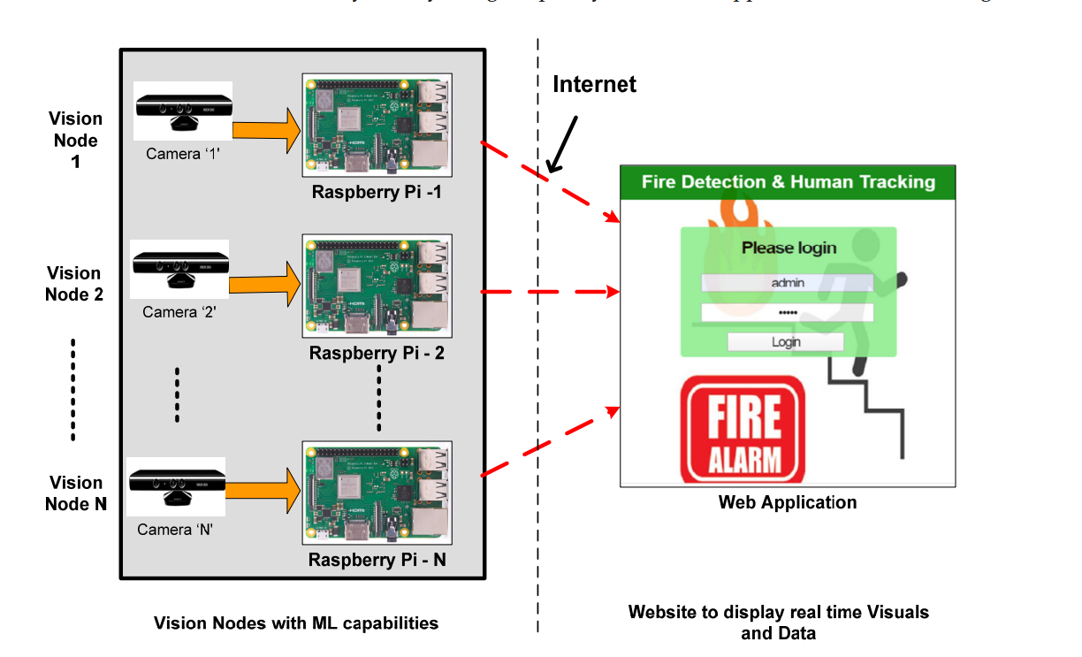
ARCHITECTURE OF THE SYSTEM

Slide 12

KEY MILESTONES
Milestone 1
Milestone 2
Milestone 3
Milestone 4
Project Proposal
1st Review
2nd Review
3rd Review
07 – 02 - 2023
11 – 02 - 2023
14– 03 - 2023
09 – 04 - 2023
0
02
03
Identifying Problem Statement, Formulating the system and Budget Estimation
Module 1 Completed
Suggestions and Final Touches
01
02
03
Oth
1st
2nd
3rd
2023
2023

Slide 13
CONCLUSION
Fire detection and people estimation are very crucial during a fire accident. Early fire detection enables suggesting a safe exit path from the building for the people inside the building. Moreover, it is important to find the number of people stuck inside the building during a fire accident. Thus, in order to detect fires and to estimate the number of people in real time, we require a real-time visual capturing system. In this project, we have implemented a vision node based on Raspberry Pi with machine learning capabilities for detecting fire and estimating people count accurately in real time. Along with the vision node, we have designed a web interface that is capable of triggering all connected vision nodes by authorized signing in to the portal. Here, the vision node interfaces with the web portal through a local server hosted on Raspberry Pi. As the vision node is switched on, it starts capturing the real-time frame. Moreover, a machine learning-based pre-trained model processes real-time frames and sends the estimated result on web portals such as the status of fire detection and count of people

Slide 14
REFERENCES
https://www.financialexpress.com/money/fire-safety-are-commercial-and-residential-spaces-in-india-safe-enough/2637244/
https://ieeexplore.ieee.org/abstract/document/341064
http://www.ijeea.in/wp-content/uploads/2021/04/Volume-9-Issue-1-Paper-6.pdf
https://www.mdpi.com/1302514

